Slide 1

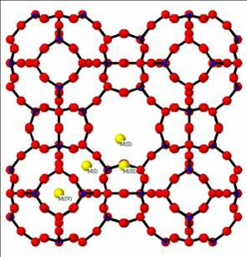
CHE-30043
Materials Chemistry & Catalysis :
Solid State Chemistry lecture 5
Rob Jackson
LJ1.16, 01782 733042
r.a.jackson@keele.ac.uk
www.facebook.com/robjteaching
@robajackson

Slide 2
Plan of lecture
The photographic effect – bands in defective materials.
Colour centres – origin of colour in insulating materials, gemstones.
Transparent Conducting Oxides – illustrated by ITO (indium tin oxide).
Non-stoichiometric materials

Slide 3
The Photographic Effect
This provides a good illustration of the link between defects and band structure in materials.
Although photographic film is less commonly used now, the process is still used by photographic labs to print digital images.

Slide 4
Silver halides
The process makes use of the silver halides, especially AgBr
How does it work?
AgBr has the rock salt structure, but unusually, cation Frenkel defects are found (cation vacancies plus interstitials).
We first review the band structure of AgBr.
  Ag has the electronic structure [Kr]4d¹⁰ 5s¹

Slide 5
The photographic effect – what happens – (i)
When light falls on an AgBr crystal, an electron is promoted from the valence band (Br levels) to the conduction band (Ag levels). The band gap is 2.7 eV.
This corresponds to a frequency
f = E / h
= 2.7 x 1.602 x 10⁻¹⁹ / 6.626 x 10⁻³⁴
= 6.528 x 10¹⁴ Hz = 459 nm (lower end of visible part of the spectrum).

Slide 6
The photographic effect – what happens (ii)
The electron, once promoted to the conduction band, can then move through the solid, and when it encounters an Ag⁺ interstitial, it will neutralise it:
Ag⁺ + e → Ag(s)
Silver atoms are then created wherever a photon strikes an AgBr crystal, leading to the formation of the dark part of the negative image.

Slide 7
Colour centres in crystals
Insulating materials normally form colourless crystals because their band gap is lies outside the visible region of the spectrum.
Coloured crystals can result, however, when defects are added to the crystal.
The first known example were the so-called F-centres*, first seen in alkali halide crystals.
* From ‘Farbe’, German for ‘colour’

Slide 8
Formation of colour centres
F-centres are produced when electrons occupy vacant anion sites in alkali halides. The colour is due to the electron absorbing and re-emitting energy at a specific wavelength.
An example of natural occurrence of F-centre is the blue-purple coloured calcium fluoride (CaF₂, fluorite) crystals which occur (known as ‘Blue John’ in Derbyshire where they are mined). (CaF₂ is colourless when pure – why?)

Slide 9
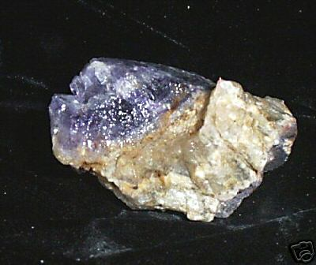
Blue John: CaF₂ with F-centres
The picture shows a sample of Blue John, CaF₂ coloured by the presence of F-centres (electrons trapped at vacant F⁻ sites in the crystal).
Blue John is mined at Castleton in Derbyshire.

Slide 10
Smoky quartz – (i)
Most semi-precious stones owe their striking colours to the presence of colour centres:
Smoky quartz is normal quartz (SiO₂) with Al³⁺ impurities (Al³⁺ ions substituted at Si⁴⁺ sites).
To maintain charge neutrality, H⁺ ions are present in the same quantity as the Al³⁺ ions.

Slide 11
Smoky quartz – (ii)
When the Al3+ initially occupies the Si⁴⁺ site, the group formed is (AlO₄)⁵⁻. An electron is then liberated and trapped by the H⁺ ion:
(AlO₄)⁵⁻ + H⁺ → (AlO₄)⁴⁻ + H
The colour centre is an (AlO₄)⁴⁻ group, which is electron deficient, and absorbs light, re-emitting it to produce a smoky colour, as shown in the next slide:

Slide 12
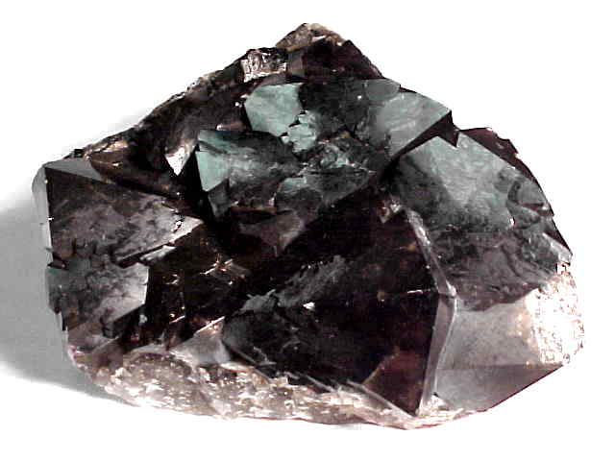
Smoky quartz – (iii)

Slide 13
Amethyst – (i)
Amethyst is produced in a similar manner to smoky quartz, but this time Fe³⁺ ions substitute at the Si⁴⁺ site, with (FeO₄)⁴⁻ colour centres giving rise to the characteristic colour of amethyst, as shown in the next slide:

Slide 14
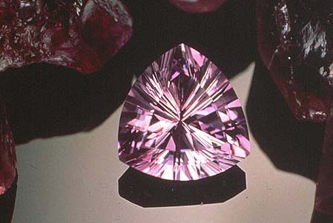
Amethyst – (ii)
The picture shows a sample of amethyst, which is quartz, SiO₂ doped with Fe³⁺ ions from Fe₂O₃.
The value of the quartz is drastically increased by the presence of a relative small number* of Fe³⁺ ions!
http://www.gemstone.org/gem-by-gem/english/amethyst.html
*’As much iron as would fit on the head of a pin can colour one cubic foot of quartz’

Slide 15
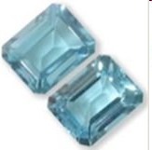
Topaz
Topaz is a more complex compound, Al₂SiO₄(F,OH)₂
The pure ‘F’ compound has a band gap of 3.35 eV (colourless!)
But it exists in a range of colours, including blue topaz as shown, which is rare (and expensive!)

Slide 16
Colour centres in topaz
The colour centres in topaz have still not been conclusively identified, but the consensus of opinion is that they are a result of:
  Doping by transition metal ions
  For blue topaz, formation of O⁻ (Al₂) centres (electron deficient)
Research continues on this topic!

Slide 17
Transparent Conducting Oxides
Pure oxides (e.g. SiO₂) are transparent and are insulators (wide band gaps).
Is it possible to obtain a transparent conducting material?
  To do this we must maintain the band gap but make conduction possible.
This is achieved by doping (similar to p- and n-type semiconductors).

Slide 18
Sn-doped In₂O₃ (‘ITO’)
ITO is formed by doping In₂O₃ with Sn
In is [Kr]4d¹⁰5s²5p¹; Sn has one more 5p electron
The material goes from an insulator (band gap 3.75 eV) to a conductor as the amount of Sn is increased.
See diagram on next slide:

Slide 19
Schematic band structure model for Sn doped In₂O₃ for small x (insulating) and large x (metallic) behaviour.
The issue as to whether the ‘impurity band’ (for large x) is separate from, or placed inside the In 5s (host) conduction band was not resolved at the time of publication.
Diagram taken from ‘Basic materials physics of transparent conducting oxides’
P. P. Edwards et al Dalton Trans. (2004) 2995

Slide 20
Conduction in ITO
When the Sn atoms are doped into the structure, a donor band from the Sn levels is formed, which is very close, or overlapping, the conduction band.
This enables conduction to occur, but, importantly the band gap is not affected.
Note that in the diagram, the In and Sn 3d levels should be 4d!

Slide 21
Applications of TCOs
TCOs have many applications, including:
  flat screen displays
  solar panels
  ‘smart’ windows
ITO can also be made into thin films, so flexible devices are possible.

Slide 22
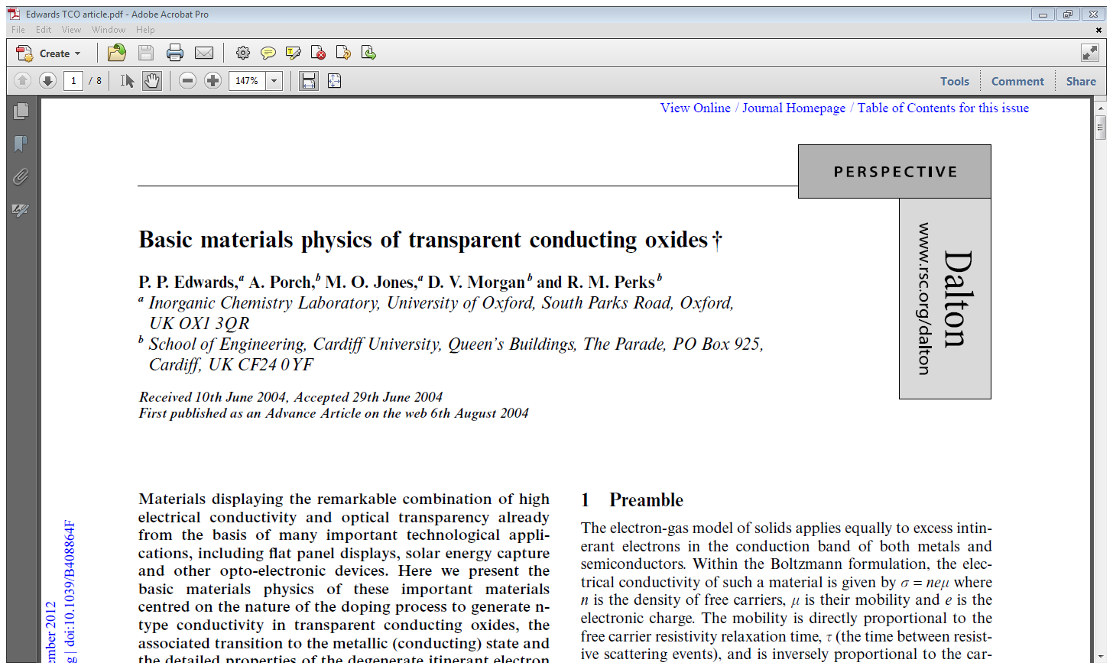
Useful reference on TCOs
(Dalton Trans. 2004, 2995-3002)

Slide 23
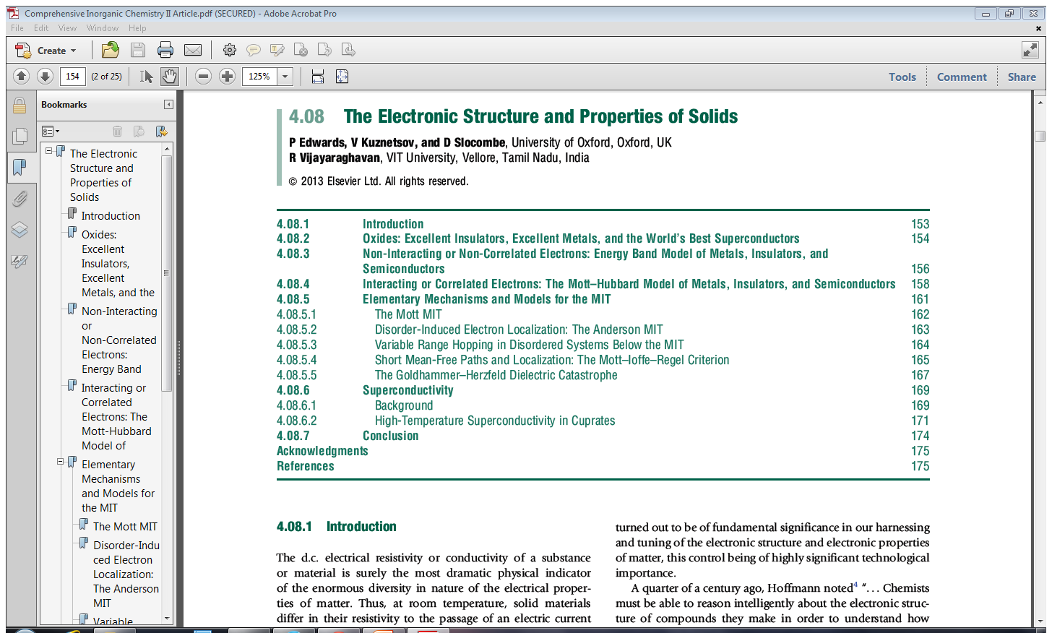
Comprehensive Inorganic Chemistry II 4 (2013)153-176

Slide 24
Non-stoichiometric materials
Some important solid state materials are non-stoichiometric, i.e. the ratio of cations to anions is not a whole number
How does this occur?
  When the metal has variable valency, e.g. Fe, which can be Fe²⁺ or Fe³⁺
How is non-stoichiometry accommodated?

Slide 25
Explanation of non-stoichiometry in a material - 1
FeO adopts the rock salt structure, but chemical analysis* shows that it is always deficient in Fe, via Fe vacancies.
  Its formula is Fe_{1-x} O
The existence of Fe²⁺ vacancies must be compensated in some way, otherwise the crystal would have a charge.
* Explained in Smart & Moore, 4th ed. pp 242-4

Slide 26
Explanation of non-stoichiometry in a material - 2
The clue to how this is done lies in the variable valency of the Fe (Fe II and Fe III).
Each Fe²⁺ vacancy can be compensated by the oxidation of two neighbouring Fe²⁺ ions to Fe³⁺ ions.
This also explains the semiconductor behaviour of FeO (next slide):

Slide 27
Semiconductor properties of FeO
FeO might be expected to be an insulator, with a filled valence band from O orbitals, and empty Fe orbitals.
But if an Fe²⁺ ion is substituted by an Fe³⁺ ion, there is one less electron per substitution, so holes are introduced into the valence band – p-type semiconduction.

Slide 28
A contrasting example – UO₂
U is another example of an element with variable valency (II –VI at least!)
In UO₂, there is metal deficiency, but this time through the presence of O interstitials (think about the structure!)
  The formula is UO_{2+x}
The excess O charge is compensated by oxidation of U⁴⁺ ions to U⁵⁺ or U⁶⁺ ions.

Slide 29
TiO : how the defect structure helps gives rise to metallic behaviour
TiO is metallic because the 3d orbitals can overlap leading to partially occupied bands (see lecture 3 notes).
This is helped because there are vacancies present in the structure (1/6 of all Ti, O sites are vacant) enable more efficient overlap of the Ti 3d orbitals (Smart and Moore, 4th ed. p262)

Slide 30
Summary of lectures: key points
Relationship between structure & properties of different materials.
Band structures & electrical conductivity.
Defects in materials & ionic conductivity.
Applications: batteries, fuel cells, TCOs.

